Slide 1
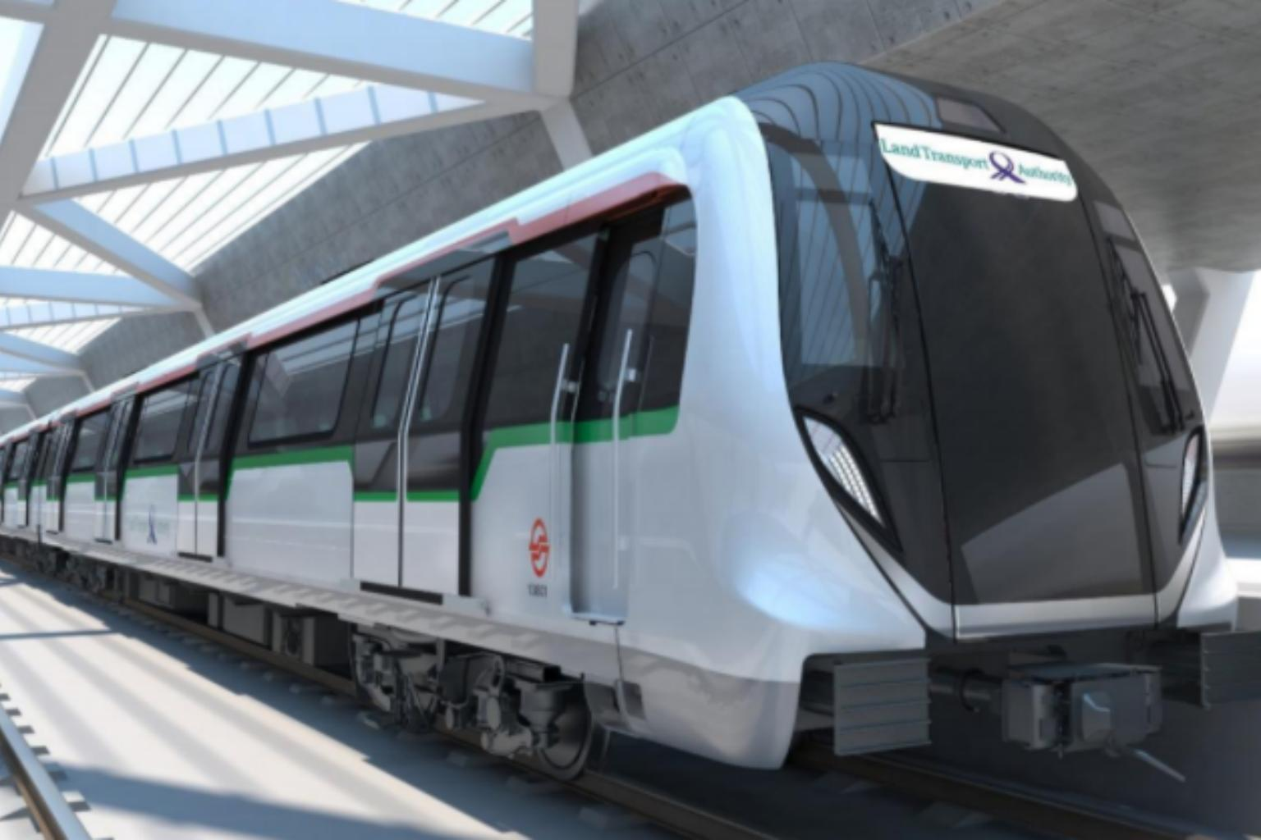
PS3: Train Condition Monitoring
Rail Vehicle Predictive Maintenance
Team Train of Thought
Meiyi, Yujie, Chongyao

Slide 2
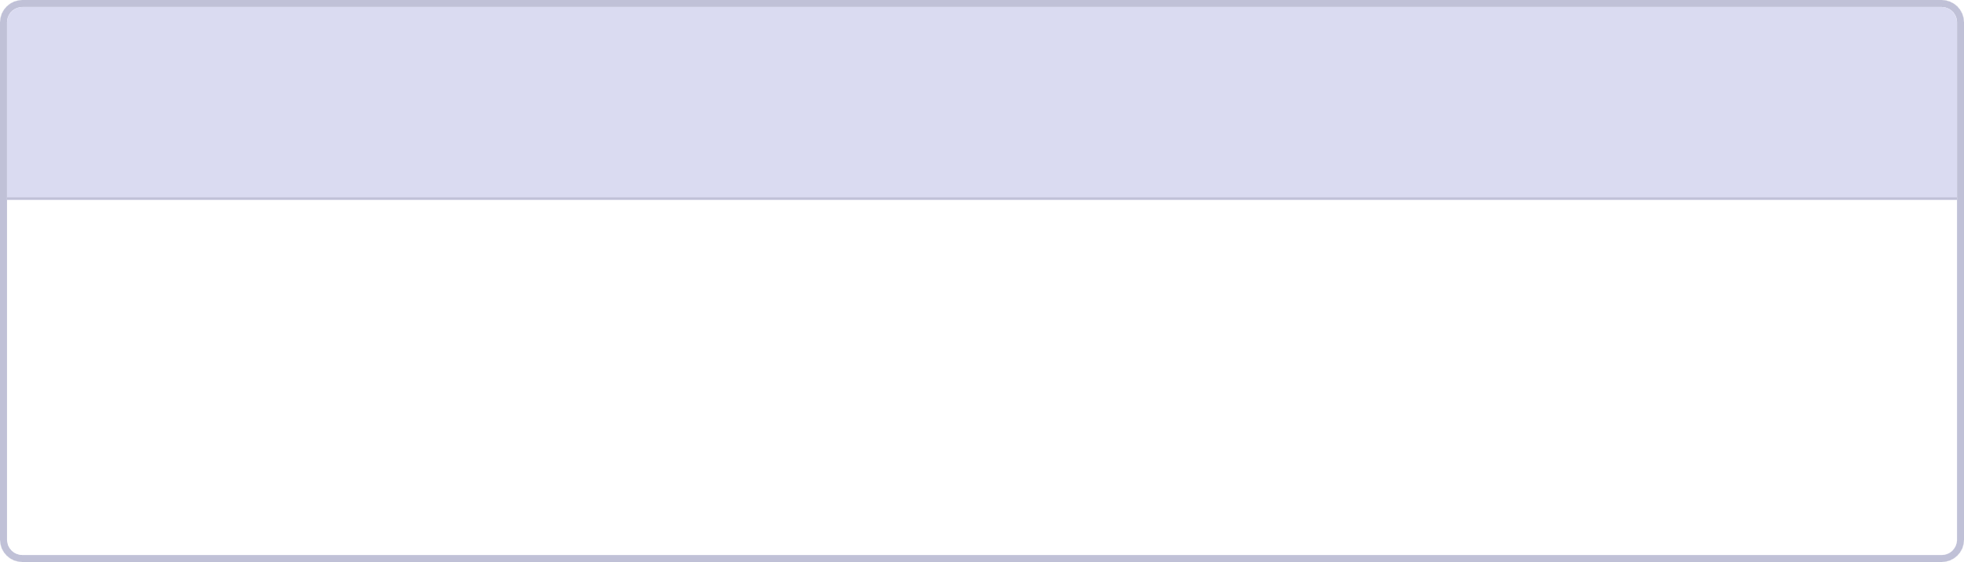
The Challenge
Rail vehicles generate huge volumes of sensor data during normal operation
Turning this into automated fault detection — instead of manual inspection or fixed thresholds — is a core condition-monitoring capability for operators
1
2
Door
ACV (HVAC)
Temporal segment detection + binary classification
Fault localisation / ranking
3
4
Rail Corrugation
SHM (Structural Health)
Multi-class classification
Regression

Slide 3
Our Approach, in One Line
For every subsystem: investigate the real data first, choose the simplest model that data actually supports, validate, then build
Leave-One-Out Cross-Validation used everywhere instead of k-fold — with classes as small as 14 examples, k-fold would leave some folds with zero minority examples, making the score meaningless
  LOOCV tests every example once, never on its own training fold.

Slide 4

Door
Task: segment each door open/close cycle from a continuous sensor stream, then classify it Normal vs. Abnormal-resistance
Method: split cycles wherever the timestamp gap exceeds 1 second, then classify each with a Logistic Regression on mean motor current, one model per operation (Open/Close)
Key finding: the logger only records rows while a door is moving, so segmentation reduces to finding gaps — and sustained current, not peak current, is what actually reveals resistance
Result: LOO score = 0.9909 (IoU-weighted F1) — Open cycles 100% accurate, Close cycles 98.2%

Slide 5
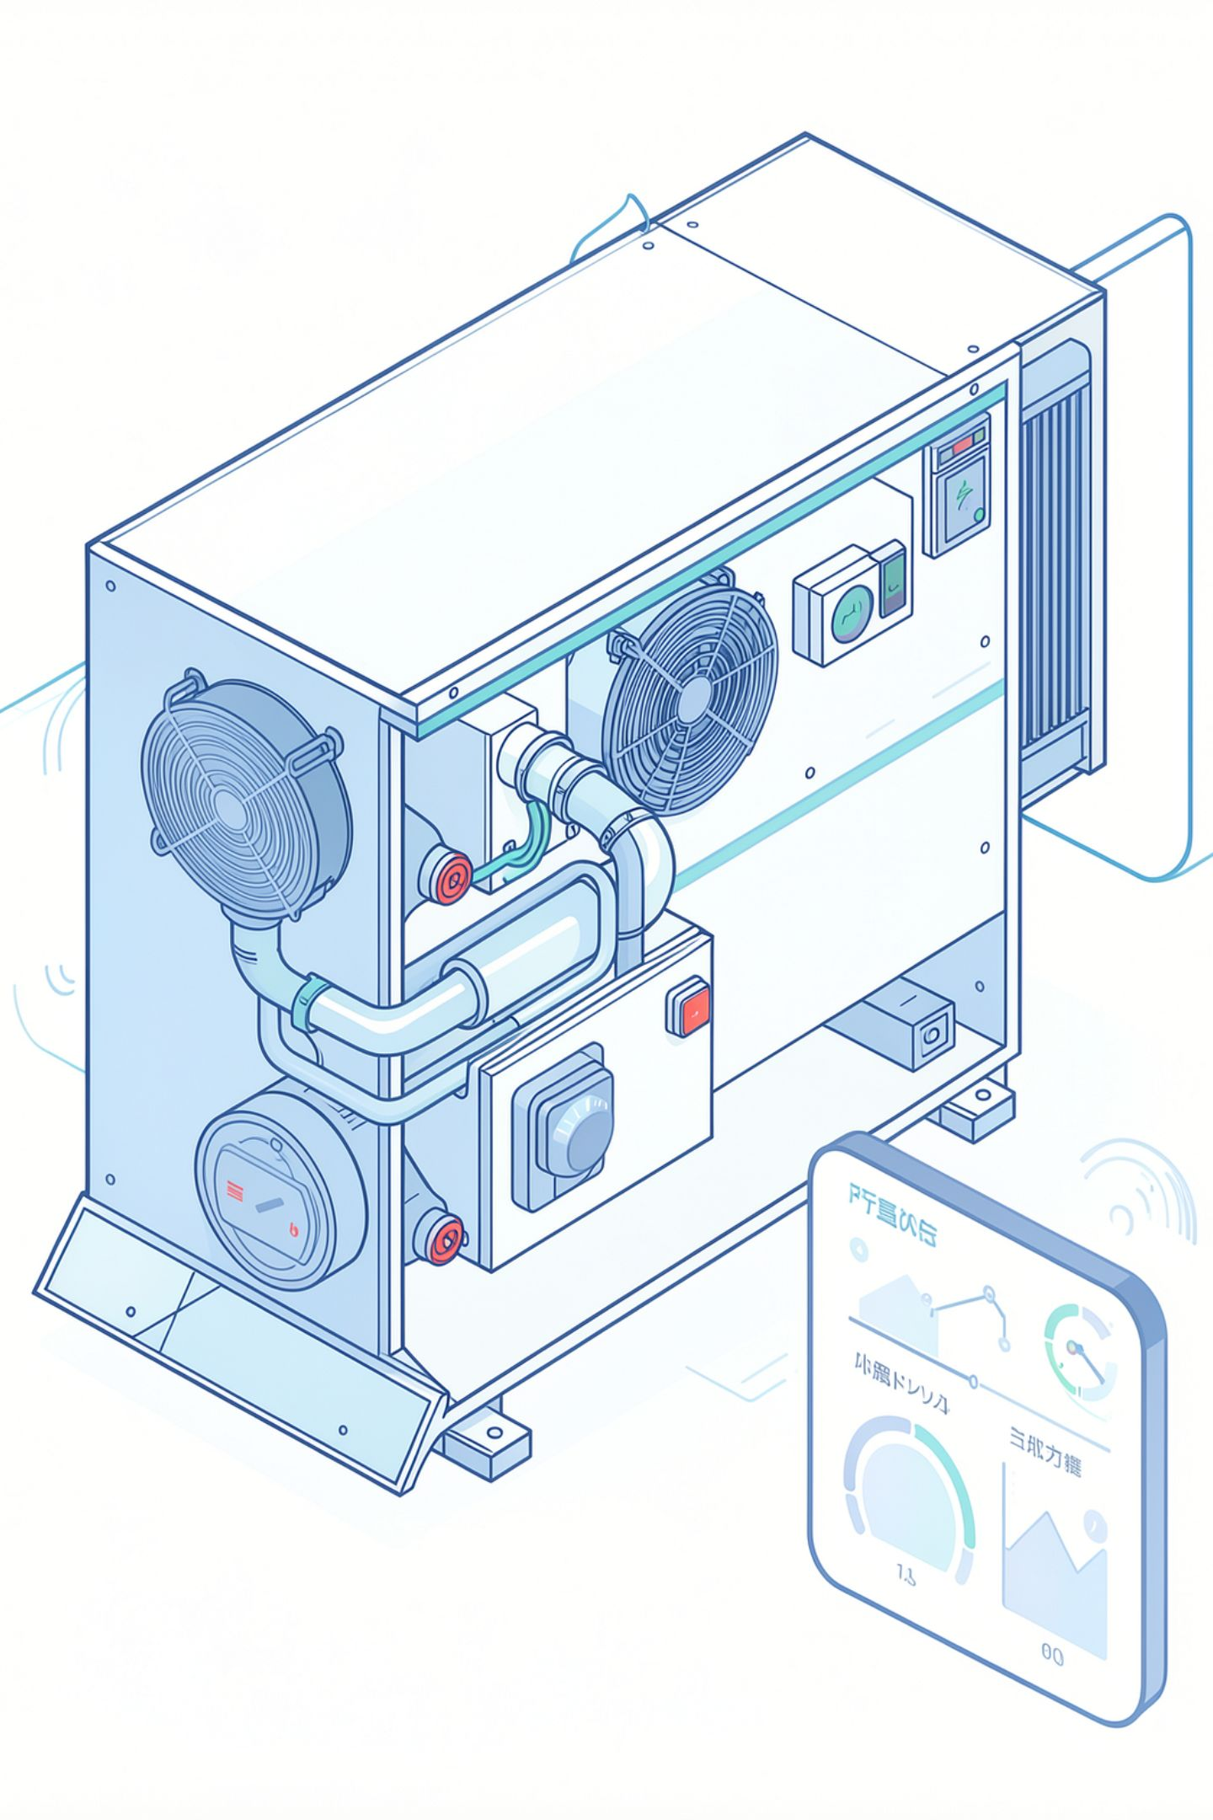
ACV — Cooling Behaviour
Task: identify which of 8 rail cars has a refrigerant leak, from multi-car HVAC telemetry
Approach: for each car, compute mean cooling error (indoor temperature minus cooling control target) across its valid telemetry; rank cars by that error, worst first
Scoring: judged by linear rank-decay — (n − (r−1)) / n — so narrowing to a shortlist still earns partial credit, not just an exact top-1 hit
Validated against 6 labelled training cases: 5 score perfectly (true faulty car ranked #1); a schema-robustness gap was found and is being tracked (see Known Limitations)

Slide 6
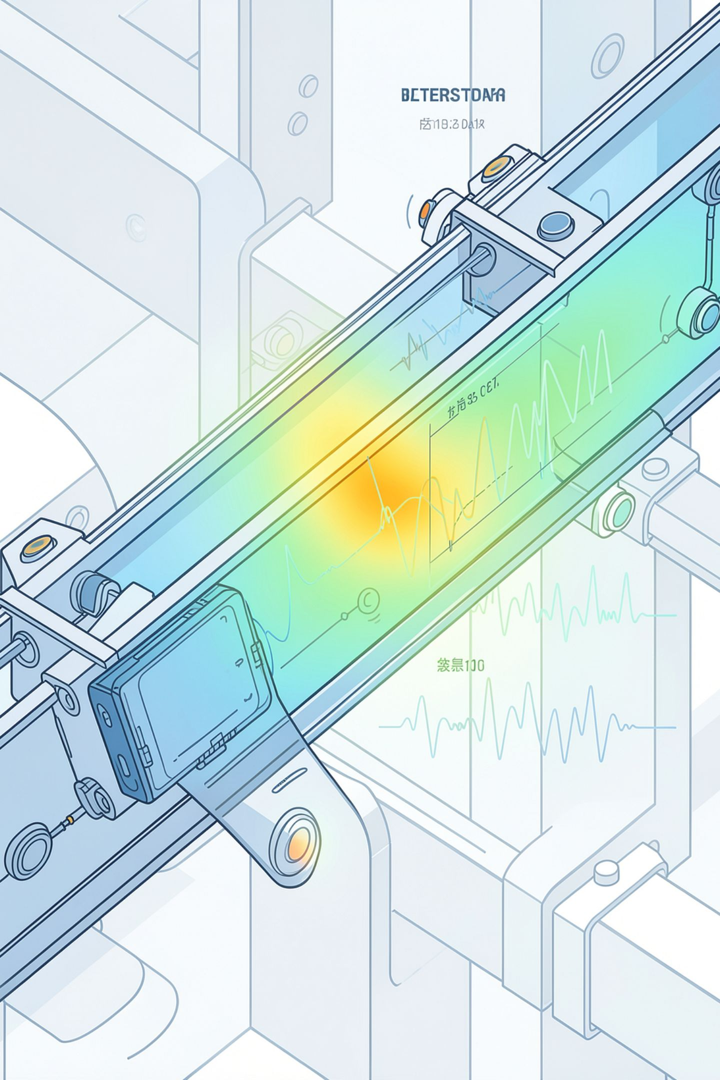
SHM — Recovering a Physical Constant From Data
Task: estimate cumulative fatigue damage from a raw dynamic-stress time series
Method: ASTM E1049 rainflow cycle counting extracts discrete stress cycles from the raw signal; Miner's-rule physics model estimates damage as proportional to Σ(cycle_count × amplitude^m) for a material fatigue exponent m
Key finding: rather than assuming m, it was grid-searched across candidate values — m = 5 won decisively, with the Leave-One-Out score peaking sharply at exactly that value (0.52 at m=4, 0.97 at m=5, 0.68 at m=6). Strong evidence the model recovered the dataset's true underlying fatigue exponent, not a coincidental fit
Result: LOO score = 0.9738 at m=5 — beating a much more flexible generic RandomForest (0.9094) trained on the same data, with a single fitted parameter

Slide 7
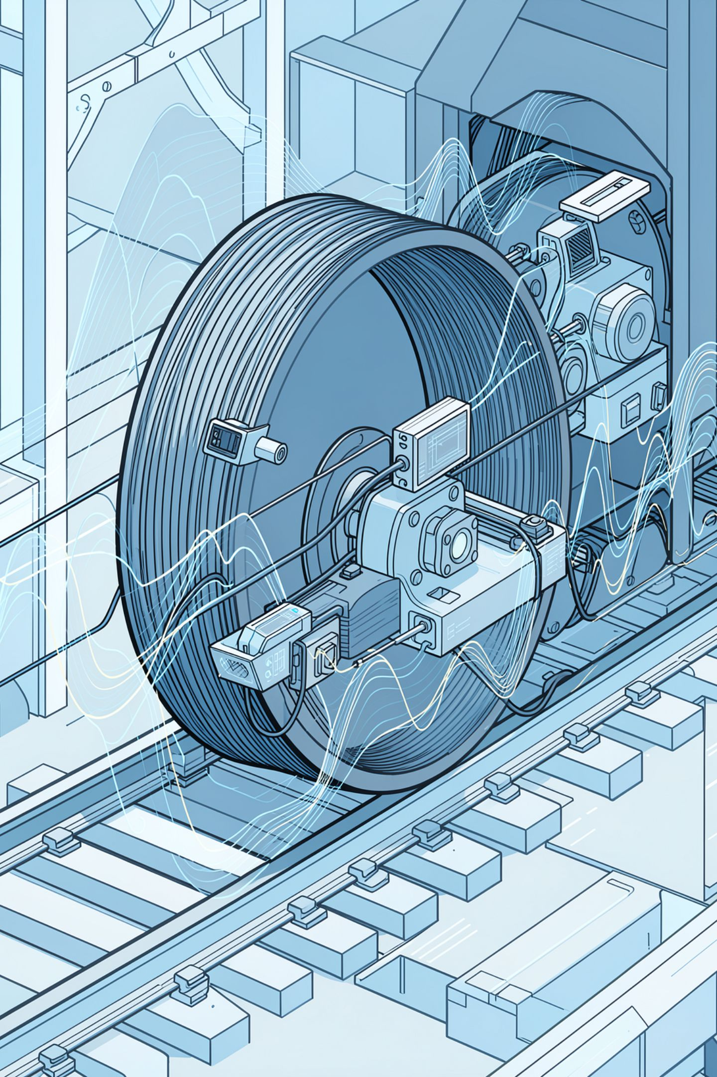
Rail Corrugation
Task: classify each recording as Normal, Side I, or Side II corrugation from 129 vibration/shock channels, severely imbalanced (234 / 14 / 24 files)
Method: 9 pooled features (magnitude + side asymmetry across RMS, kurtosis, crest factor, plus speed) feeding a class-weighted RandomForest
Key finding: two promising single features looked clean on a handful of examples but failed once tested against all 272 files, which is why the model was validated on the full set, not a shortcut
Result: macro F1 = 0.7048 — Side I is the known weak point, with only 14 training examples to define it

Slide 8
Results at a Glance
Subsystem | Metric | Score
Door | IoU-weighted F1 | 0.9909
SHM | Leave-One-Out score | 0.9738
Rail Corrugation | Macro F1 | 0.7048
ACV | Rank-decay (partial validation) | 5/6 cases perfect
Notes:
All four numbers are our own Leave-One-Out estimates on training data — the real competition score is computed by the organisers on a held-out test set we never see
Every score is reported honestly including the weak points (Door's tightest edge case, Rail Corrugation's Side I precision, ACV's schema gap) — not smoothed over

Slide 9
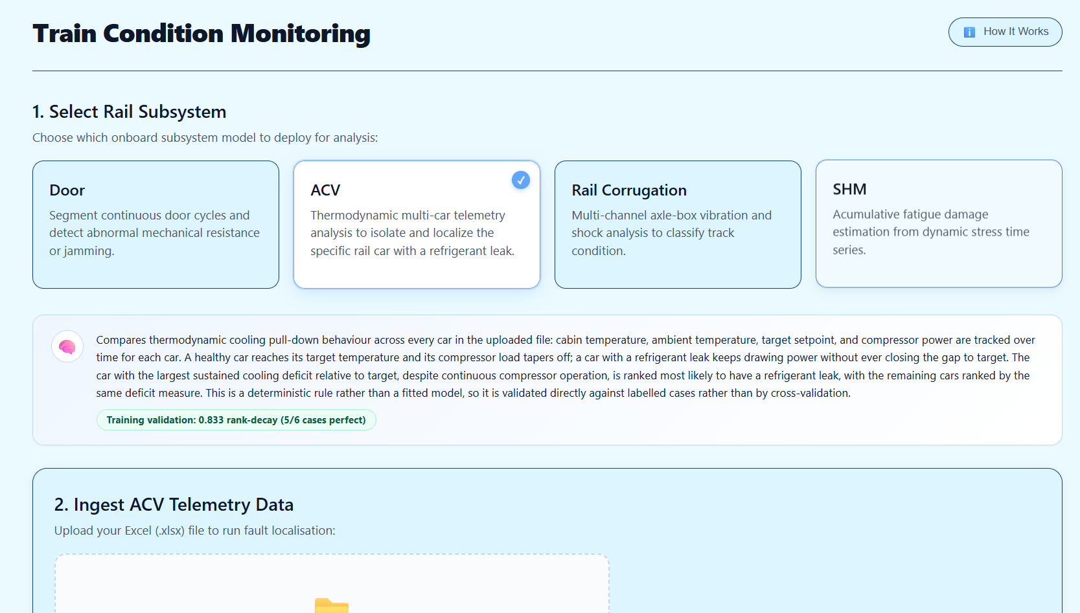
The App — One Interface, Four Models
Single lightweight Python backend (standard library http.server, no framework dependencies) + a plain HTML/CSS/JS frontend
Four independent tabs, each wired to its subsystem's real trained model
Batch upload per tab
  Select multiple files at once
Methodology panel
Self-contained deployment

Slide 10
Use Cases
Depot maintenance triage
Fleet-wide condition monitoring
Rapid model validation for judges/reviewers
Engineer drags in a batch of vehicles' sensor logs before a scheduled maintenance window and gets flagged predictions back in seconds, with plain-language reasoning for each subsystem
Run all four subsystems across an entire fleet's logs in one sitting for focused maintenance work, e.g. Corrugation classification tells you which rail side needs grinding
Live, working pipeline to interact with directly
Downstream integration
Engineering onboarding
JSON/CSV export means predictions can feed directly into a larger maintenance-scheduling or asset-management system without manual re-entry
Methodology panel doubles as a teaching tool for new team members to understand what each model actually keys off, without reading source code

Slide 11
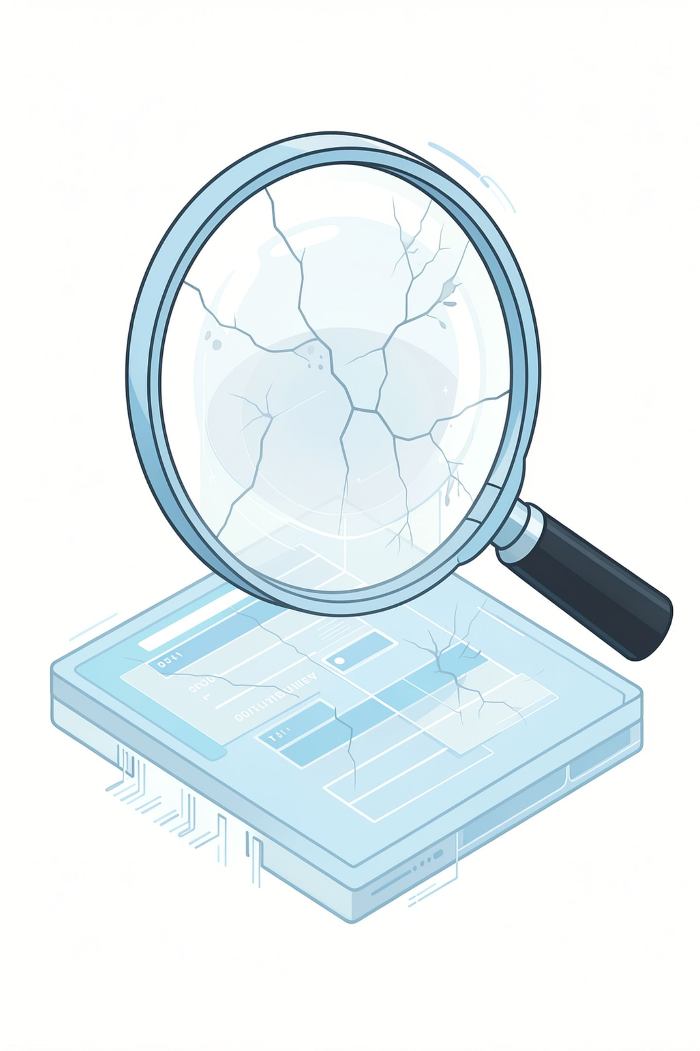
Known Limitations
Door: one training example sits exactly at the tightest class boundary (Close operation); Leave-One-Out correctly flags this as the model's most fragile point
Rail Corrugation: Side I precision is low (0.31) — only 14 training examples define that class's boundary in a 9-feature space with genuine overlap; more labelled Side I data is the direct fix, not more model complexity
ACV: the fault-ranking rule assumes a specific telemetry schema (pre-aggregated indoor/outdoor temperatures); one of six labelled training cases uses a substantially different raw signal schema (60+ low-level signals) that the current pipeline cannot yet parse
Speed confound in Rail Corrugation: disclosed and checked, but not eliminated — a limitation of how the training data was collected, not of the modelling approach

Slide 12

Next Steps
Rail Corrugation: Frequency-domain (FFT) features tuned to the speed/wavelength relationship, specifically targeting Side I precision
ACV: Extend pipeline to map the alternate raw-signal schema onto the same cooling-error logic
  Robust to both telemetry formats
Bootstrap confidence intervals around each Leave-One-Out score, to quantify variation of estimates

Slide 13
Thank You

